Slide 1

Chapter 6:
Project Time Management
Information Technology Project Management, Seventh Edition
Note: See the text itself for full citations.

Slide 2
Learning Objectives
Understand the importance of project schedules and good project time management
Discuss the process of planning schedule management
Define activities as the basis for developing project schedules
Describe how project managers use network diagrams and dependencies to assist in activity sequencing
Understand the relationship between estimating resources and project schedules
Explain how various tools and techniques help project managers perform activity duration estimates

Slide 3
Learning Objectives
Use a Gantt chart for planning and tracking schedule information, find the critical path for a project, and describe how critical chain scheduling and the Program Evaluation and Review Technique (PERT) affect schedule development
Discuss how reality checks and discipline are involved in controlling and managing changes to the project schedule
Describe how project management software can assist in project time management and review words of caution before using this software

Slide 4
Importance of Project Schedules
Managers often cite delivering projects on time as one of their biggest challenges
Time has the least amount of flexibility; it passes no matter what happens on a project
Schedule issues are the main reason for conflicts on projects, especially during the second half of projects

Slide 5
Individual Work Styles and Cultural Differences Cause Schedule Conflicts
One dimension of the Meyers-Briggs Type Indicator focuses on peoples’ attitudes toward structure and deadline
Some people prefer to follow schedules and meet deadlines while others do not (J vs. P)
Difference cultures and even entire countries have different attitudes about schedules

Slide 6
迈尔斯布里格斯类型指标(MBTI)表征人的性格，是由美国的凯恩琳·布里格斯和她的女儿伊莎贝尔·布里格斯·迈尔斯制定的。该指标以瑞士心理学家荣格划分的8种类型为基础，加以扩展，形成四个维度，每个点对应每个人的性格。
  ① 外倾(E)－内倾(I)
  ② 感觉(S)－直觉(N)
  ③ 思维(T)－情感(F)
  ④ 判断(J)－知觉(P)

Slide 7
Project Time Management Processes
Planning schedule management: determining the policies, procedures, and documentation that will be used for planning, executing, and controlling the project schedule
Defining activities: identifying the specific activities that the project team members and stakeholders must perform to produce the project deliverables
Sequencing activities: identifying and documenting the relationships between project activities
Estimating activity resources: estimating how many resources a project team should use to perform project activities
Estimating activity durations: estimating the number of work periods that are needed to complete individual activities
Developing the schedule: analyzing activity sequences, activity resource estimates, and activity duration estimates to create the project schedule
Controlling the schedule: controlling and managing changes to the project schedule

Slide 8
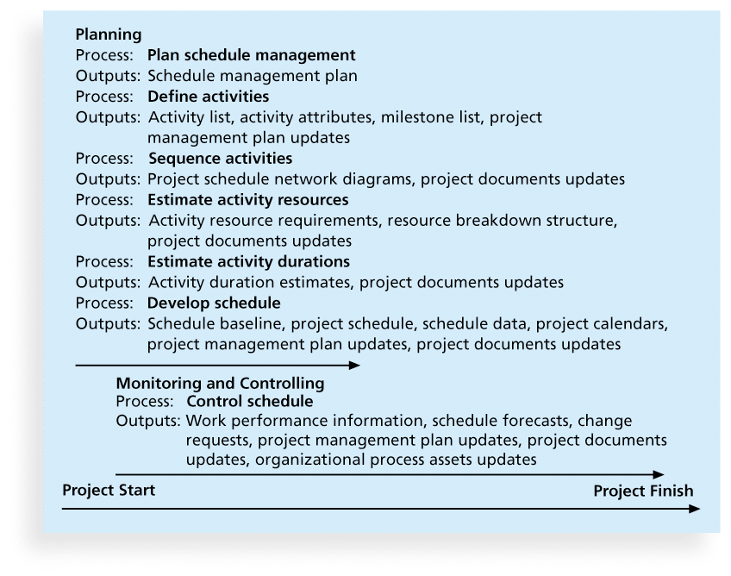
Figure 6-1. Project Time Management Summary

Slide 9
Planning Schedule Management
The project team uses expert judgment, analytical techniques, and meetings to develop the schedule management plan
A schedule management plan includes:
  Project schedule model development
  The scheduling methodology
  Level of accuracy and units of measure
  Control thresholds
  Rules of performance measurement
  Reporting formats
  Process descriptions

Slide 10
Defining Activities
An activity or task is an element of work normally found on the work breakdown structure (WBS) that has an expected duration, a cost, and resource requirements
Activity definition involves developing a more detailed WBS and supporting explanations to understand all the work to be done so you can develop realistic cost and duration estimates

Slide 11
Activity Lists and Attributes
An activity list is a tabulation of activities to be included on a project schedule that includes
  the activity name
  an activity identifier or number
  a brief description of the activity
Activity attributes provide more information such as predecessors, successors, logical relationships, leads and lags, resource requirements, constraints, imposed dates, and assumptions related to the activity

Slide 12
Milestones
A milestone is a significant event that normally has no duration
It often takes several activities and a lot of work to complete a milestone
They’re useful tools for setting schedule goals and monitoring progress
Examples include obtaining customer sign-off on key documents or completion of specific products

Slide 13
Sequencing Activities
Involves reviewing activities and determining dependencies
A dependency or relationship is the sequencing of project activities or tasks
You must determine dependencies in order to use critical path analysis

Slide 14
Three types of Dependencies
Mandatory dependencies: inherent in the nature of the work being performed on a project, sometimes referred to as hard logic
Discretionary dependencies: defined by the project team., sometimes referred to as soft logic and should be used with care since they may limit later scheduling options
External dependencies: involve relationships between project and non-project activities

Slide 15
Network Diagrams
Network diagrams are the preferred technique for showing activity sequencing
A network diagram is a schematic display of the logical relationships among, or sequencing of, project activities
Two main formats are the arrow and precedence diagramming methods

Slide 16
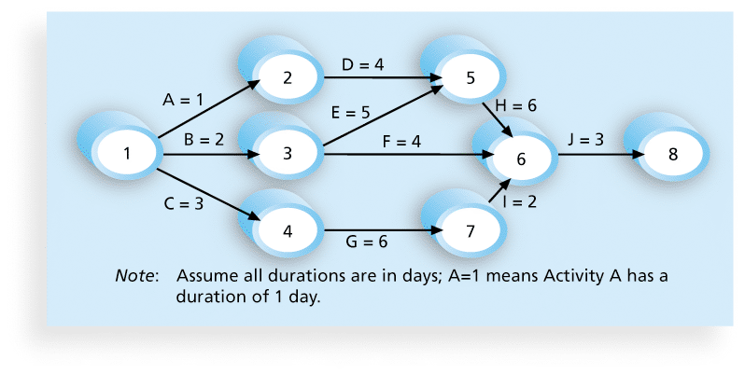
Figure 6-2. Network Diagram for Project X

Slide 17
Arrow Diagramming Method (ADM)
Also called activity-on-arrow (AOA) network diagrams
Activities are represented by arrows
Nodes or circles are the starting and ending points of activities
Can only show finish-to-start dependencies

Slide 18
Process for Creating AOA Diagrams
1. Find all of the activities that start at node 1. Draw their finish nodes and draw arrows between node 1 and those finish nodes. Put the activity letter or name and duration estimate on the associated arrow
2. Continuing drawing the network diagram, working from left to right. Look for bursts and merges. Bursts occur when a single node is followed by two or more activities. A merge occurs when two or more nodes precede a single node
3. Continue drawing the project network diagram until all activities are included on the diagram that have dependencies
4. As a rule of thumb, all arrowheads should face toward the right, and no arrows should cross on an AOA network diagram

Slide 19
Precedence Diagramming Method (PDM)
Activities are represented by boxes
Arrows show relationships between activities
More popular than ADM method and used by project management software
Better at showing different types of dependencies

Slide 20
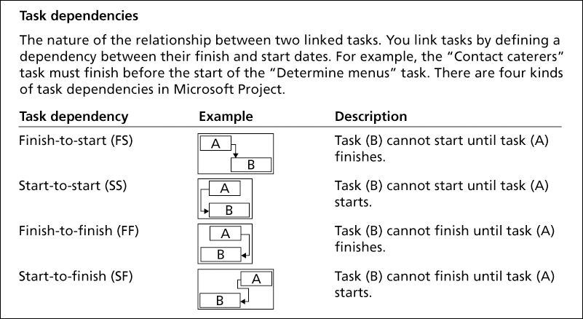
Figure 6-3. Task Dependency Types

Slide 21
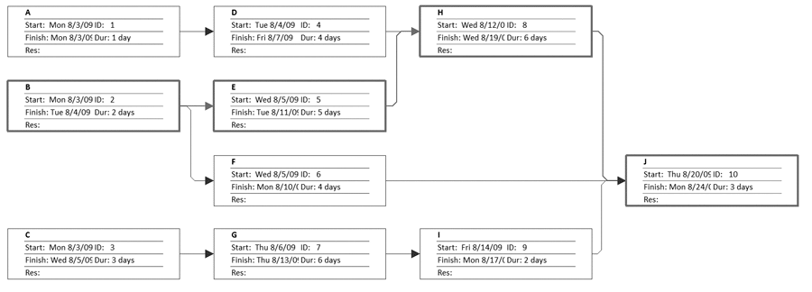
Figure 6-4. Sample PDM Network Diagram

Slide 22
Estimating Activity Resources
Before estimating activity durations, you must have a good idea of the quantity and type of resources that will be assigned to each activity; resources are people, equipment, and materials
Consider important issues in estimating resources
  How difficult will it be to do specific activities on this project?
  What is the organization’s history in doing similar activities?
  Are the required resources available?
A resource breakdown structure is a hierarchical structure that identifies the project’s resources by category and type

Slide 23
Activity Duration Estimating
Duration includes the actual amount of time worked on an activity plus elapsed time
Effort is the number of workdays or work hours required to complete a task
Effort does not normally equal duration
People doing the work should help create estimates, and an expert should review them

Slide 24
Three-Point Estimates
Instead of providing activity estimates as a discrete number, such as four weeks, it’s often helpful to create a three-point estimate
  an estimate that includes an optimistic, most likely, and pessimistic estimate, such as three weeks for the optimistic, four weeks for the most likely, and five weeks for the pessimistic estimate
Three-point estimates are needed for PERT and Monte Carlo simulations

Slide 25
Developing the Schedule
Uses results of the other time management processes to determine the start and end date of the project
Ultimate goal is to create a realistic project schedule that provides a basis for monitoring project progress for the time dimension of the project
Important tools and techniques include Gantt charts, critical path analysis, and critical chain scheduling, and PERT analysis

Slide 26
Gantt Charts
Gantt charts provide a standard format for displaying project schedule information by listing project activities and their corresponding start and finish dates in a calendar format
Symbols include:
  A black diamond: a milestones
  Thick black bars: summary tasks
  Lighter horizontal bars: durations of tasks
  Arrows: dependencies between tasks

Slide 27
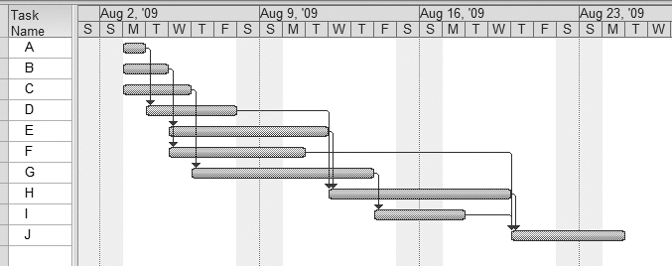
Figure 6-5. Gantt Chart for Project X

Slide 28
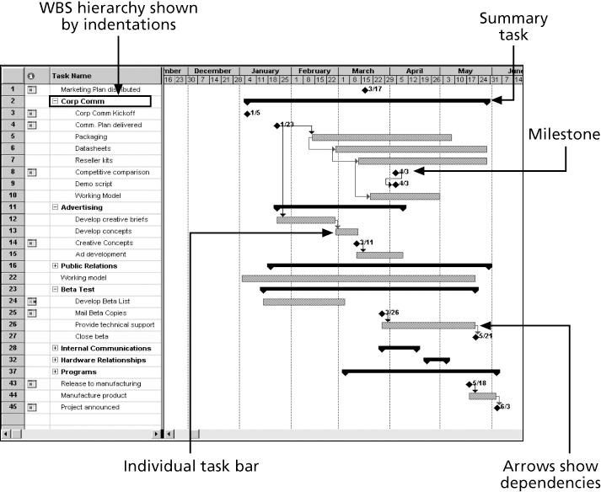
Figure 6-6. Gantt Chart for Software Launch Project

Slide 29
Adding Milestones to Gantt Charts
Many people like to focus on meeting milestones, especially for large projects
Milestones emphasize important events or accomplishments on projects
Normally create milestone by entering tasks with a zero duration, or you can mark any task as a milestone

Slide 30
SMART Criteria
Milestones should be
  Specific
  Measurable
  Assignable
  Realistic
  Time-framed

Slide 31
Best Practice
Schedule risk is inherent in the development of complex systems. Luc Richard, the founder of www.projectmangler.com, suggests that project managers can reduce schedule risk through project milestones, a best practice that involves identifying and tracking significant points or achievements in the project. The five key points of using project milestones include the following:
  1. Define milestones early in the project and include them in the Gantt chart to provide a visual guide
  2. Keep milestones small and frequent
  3. The set of milestones must be all-encompassing
  4. Each milestone must be binary, meaning it is either complete or incomplete.
  5. Carefully monitor the critical path

Slide 32
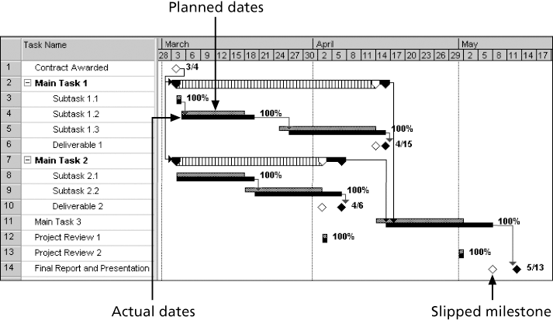
Figure 6-7. Sample Tracking Gantt Chart

Slide 33
Critical Path Method (CPM)
CPM is a network diagramming technique used to predict total project duration
A critical path for a project is the series of activities that determines the earliest time by which the project can be completed
The critical path is the longest path through the network diagram and has the least amount of slack or float
Slack or float is the amount of time an activity may be delayed without delaying a succeeding activity or the project finish date

Slide 34
Calculating the Critical Path
First develop a good network diagram
Add the duration estimates for all activities on each path through the network diagram
The longest path is the critical path
If one or more of the activities on the critical path takes longer than planned, the whole project schedule will slip unless the project manager takes corrective action

Slide 35
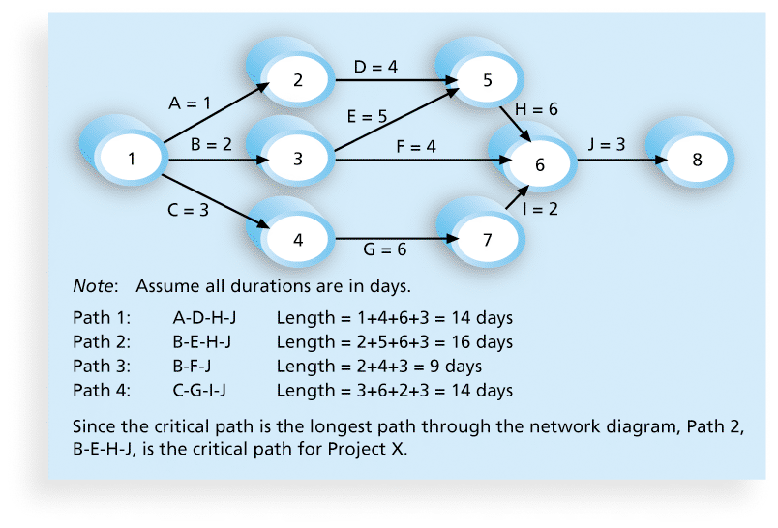
Figure 6-8. Determining the Critical Path for Project X

Slide 36
Using Critical Path Analysis to Make Schedule Trade-offs
Free slack or free float is the amount of time an activity can be delayed without delaying the early start of any immediately following activities
Total slack or total float is the amount of time an activity may be delayed from its early start without delaying the planned project finish date
A forward pass through the network diagram determines the early start and finish dates
A backward pass determines the late start and finish dates

Slide 37
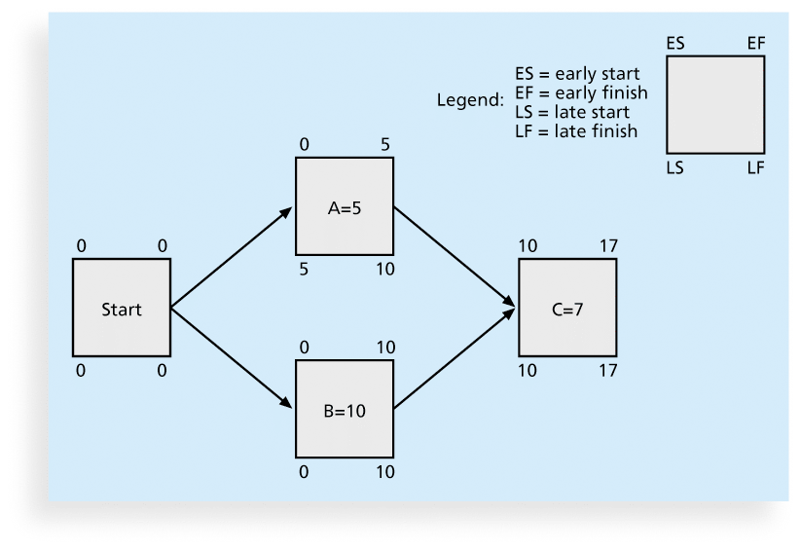
Figure 6-9. Calculating Early and Late Start and Finish Dates

Slide 38
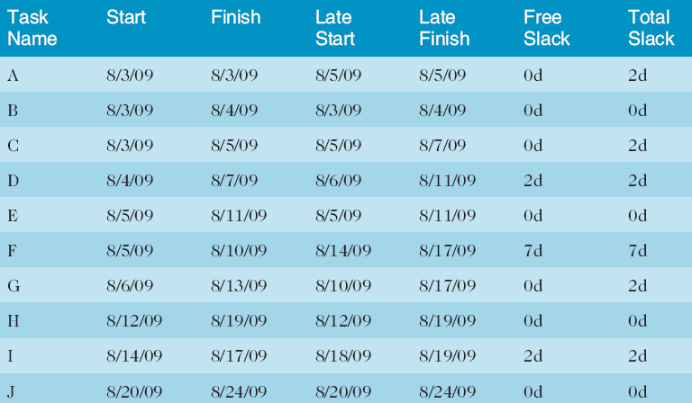
Table 6-1. Free and Total Float or Slack for Project X

Slide 39
Using the Critical Path to Shorten a Project Schedule
Three main techniques for shortening schedules
  Shortening durations of critical activities/tasks by adding more resources or changing their scope
  Crashing activities by obtaining the greatest amount of schedule compression for the least incremental cost
  Fast tracking activities by doing them in parallel or overlapping them

Slide 40
Importance of Updating Critical Path Data
It is important to update project schedule information to meet time goals for a project
The critical path may change as you enter actual start and finish dates
If you know the project completion date will slip, negotiate with the project sponsor

Slide 41
Critical Chain Scheduling
Critical chain scheduling
  a method of scheduling that considers limited resources when creating a project schedule and includes buffers to protect the project completion date
Uses the Theory of Constraints (TOC)
  a management philosophy developed by Eliyahu M. Goldratt and introduced in his book The Goal.
Attempts to minimize multitasking
  when a resource works on more than one task at a time

Slide 42
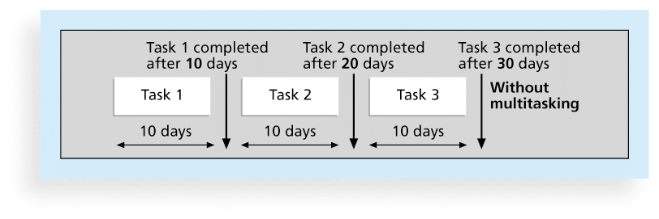
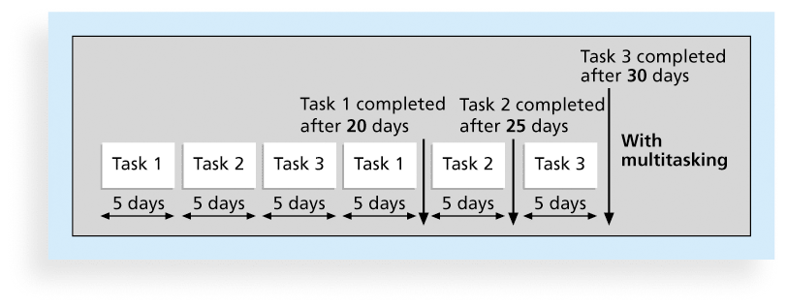
Figures 6-10.a and b. Multitasking Example

Slide 43
Buffers and Critical Chain
A buffer is additional time to complete a task
Murphy’s Law states that if something can go wrong, it will
Parkinson’s Law states that work expands to fill the time allowed
In traditional estimates, people often add a buffer to each task and use it if it’s needed or not
Critical chain scheduling removes buffers from individual tasks and instead creates
  a project buffer or additional time added before the project’s due date
  feeding buffers or additional time added before tasks on the critical path

Slide 44
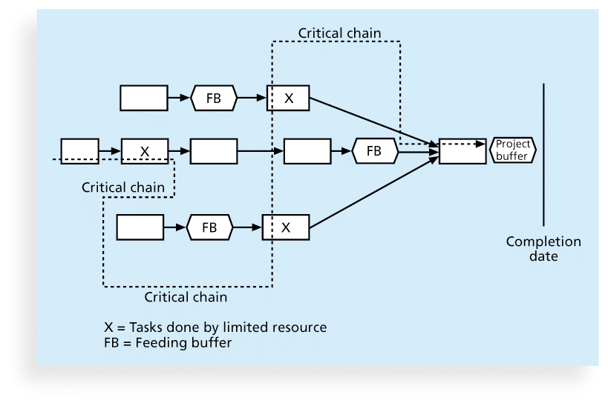
Figure 6-11. Example of Critical Chain Scheduling

Slide 45
Program Evaluation and Review Technique (PERT)
PERT is a network analysis technique used to estimate project duration when there is a high degree of uncertainty about the individual activity duration estimates
PERT uses probabilistic time estimates
  duration estimates based on using optimistic, most likely, and pessimistic estimates of activity durations, or a three-point estimate

Slide 46
PERT Formula and Example
PERT weighted average =
optimistic time + 4X most likely time + pessimistic time
6
Example:
PERT weighted average =
8 workdays + 4 X 10 workdays + 24 workdays = 12 days 6
where optimistic time= 8 days
most likely time = 10 days, and
pessimistic time = 24 days
Therefore, you’d use 12 days on the network diagram instead of 10 when using PERT for the above example

Slide 47
Schedule Control Suggestions
Perform reality checks on schedules
Allow for contingencies
Don’t plan for everyone to work at 100% capacity all the time
Hold progress meetings with stakeholders and be clear and honest in communicating schedule issues

Slide 48
Controlling the Schedule
Goals are to know the status of the schedule, influence factors that cause schedule changes, determine that the schedule has changed, and manage changes when they occur
Tools and techniques include
  Progress reports
  A schedule change control system
  Project management software, including schedule comparison charts like the tracking Gantt chart
  Variance analysis, such as analyzing float or slack
  Performance management, such as earned value (chapter 7)

Slide 49
Reality Checks on Scheduling
First review the draft schedule or estimated completion date in the project charter
Prepare a more detailed schedule with the project team
Make sure the schedule is realistic and followed
Alert top management well in advance if there are schedule problems

Slide 50
Chapter Summary
Project time management is often cited as the main source of conflict on projects, and most IT projects exceed time estimates
Main processes include
  Plan schedule management
  Define activities
  Sequence activities
  Estimate activity resources
  Estimate activity durations
  Develop schedule
  Control schedule

